Slide 1
Chapter 15, Article V NOISE POLLUTION CONTROL ORDINANCE Comprehensive Review Status Report Environmental Protection Commission
Environmental Protection Division
May 2024

Slide 2
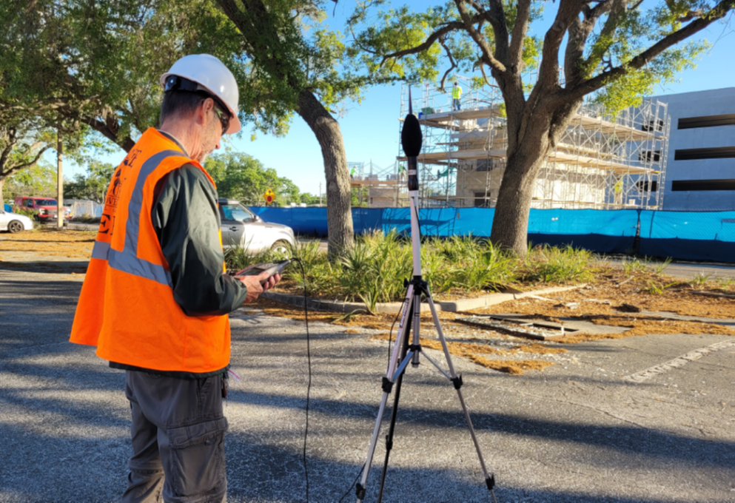
Presentation Outline
Background
Engagement and Activities
Phase 1 Results
Phase 2 Approach
Summary
2

Slide 3
Background March 2024 EPC Work Session
On March 27, 2024, we presented to this Commission the proposed approach to review and modify the Orange County Noise Pollution Control Ordinance.
The Environmental Protection Division (EPD) contracted with Tetra Tech/Grove Scientific to perform the review and provide suggested modifications to the ordinance using a two-phase approach.
3

Slide 4
Background March 2024 EPC Work Session
Phased approach
Key elements and objectives
Phase 1:
Task 1 – Evaluation of Sound Level Limits and Plainly Audible Standard
Task 2 – Comparative Analysis of Noise Ordinances
Phase 2:
Task 1 – Enforcement Procedures and Penalties
Task 2 – Code Exemptions and Variances
Task 3 – Legally Defensible Measurement for Plainly Audible Standard
Task 4 – Stakeholder Engagement
Task 5 – Recommendations and Draft Code Revisions
Assess the effectiveness, considering allowable sound level limits and the “plainly audible” standard
Identify the strengths and weaknesses
Compare with other noise regulations at different jurisdictions
Evaluate a mechanism to address compatibility issues
Conduct stakeholder engagement
Provide recommendations and draft code revisions
4
Notes:
PHASE 1
Task 1 – Evaluation of Sound Level Limits and Plainly Audible Standard
Assess the current Orange County ordinance sound level limits for different land use categories, such as residential, noise-sensitive zones, and non-residential areas. Compare these limits with nationally recognized standards and best practices. Evaluate the use of impact fees based on the uses level of noise emissions. Add units of noise measurement, and other quantitative definitions to the revised ordinance.
Review the application of the plainly audible standard for noise determination and the distances specified for residential and non-residential areas. Examine the use of others' personal hearing abilities to enforce the plainly audible standard and its potential subjectivity.
Task 2 – Comparative Analysis of Noise Ordinances
The Tetra Tech Team will conduct a thorough comparison of the Orange County noise ordinance with other jurisdictions within Orange County and similar urban counties (based on demographics) in Florida, nationwide and international, that use the plainly audible standard and land use sound levels.
The Tetra Tech Team will evaluate the varying distances used for the plainly audible standard in different jurisdictions and consider potential implications for Orange County. Collate the data into a table comparing orange county audible standards to the other jurisdictions chosen to compare County ordinance.
Evaluate constitutional and first amendment standing of proposed noise ordinance revisions.
Evaluate Orange County ordinance consistency with City of Orlando Downtown Sound Attenuation LDC Amendment- May 2022.
Evaluate Orange County ordinance consistency with Florida Statute 316.3045, Operation of radios or other mechanical sound making devices or instruments in vehicles.
Consider a gas-powered leaf blower ban. Many states and cities across the US have enacted bans due to noise, but also for emissions/climate change.
PHASE 2
Task 1 – Enforcement Procedures and Penalties
The Tetra Tech Team will review the enforcement procedures for noise violations, including the issuance of warnings and citations. Assess the effectiveness of these procedures in resolving complaints.
Examine the penalties for noise ordinance violations and consider adjustments or increased penalty amounts if needed. Collate the enforcement and penalty data into a comparison table.
Identify potential areas for improvement and recommend changes.
Task 2 – Code Exemptions and Variances
The Tetra Tech Team will evaluate the existing exemptions in the noise ordinance and compare them to variance procedures, identifying potential areas for improvement.
The Team will determine the necessity and appropriateness of each code exemption and recommend changes if necessary.
Task 3 – Legally Defensible Measurement for Plainly Audible Standard
The Tetra Tech Team will propose a legally defensible method for measuring the distance for the plainly audible standard, taking into account best practices and legal requirements.
Task 4 – Stakeholder Engagement
The Tetra Tech Team will plan and conduct stakeholder meetings to gather input and feedback on the evaluation findings and proposed code revisions and develop an interfacing website for public engagement.
Task 5 – Recommendations and Draft Code Revisions
The Tetra Tech Team will provide recommendations based on the evaluation findings and stakeholder input.

Slide 5
Background Noise Pollution Control Ordinance Overview
Orange County’s Noise Pollution Control Ordinance (Chapter 15, Article V) prohibits noise that is either:
More than the allowable sound level limits, or
Is plainly audible from a specified distance.
EPD and the Orange County Sheriff Office (OCSO) share responsibilities under the Noise Pollution Control Ordinance.
5

Slide 6
Background Noise Pollution Control Ordinance Overview
Environmental Protection Division (EPD)
Enforces sound emanating from commercial and industrial Facilities under Section 15-182, Table 1:
Table 1: Code Standard - Sound assessed using sound level meter (dB=decibels) time weighted average
Land Use Category | Measurement | Time of Day | Sound Level Limit (dBA)
Noise Sensitive Zone | Time Averaged (LEQ) | Any time | 55 dB
 | Impulsive | 7:00 a.m. - 10:00 p.m. | 60 dB
 | Impulsive | 10:01 p.m. - 6:59 a.m. | Not allowed
Residential Area | Time Averaged (LEQ) | 7:00 a.m. - 10:00 p.m. | 60 dB
 | Time Averaged (LEQ) | 10:01 p.m. - 6:59 a.m. | 55 dB
 | Impulsive | 7:00 a.m. - 10:00 p.m. | 65 dB
 | Impulsive | 10:01 p.m. - 6:59 a.m. | Not allowed
6

Slide 7
Background Noise Pollution Control Ordinance Overview
Orange County Sheriff’s Office (OCSO)
Enforces sound emanating from residential and commercial sites which may involve the consumption of alcohol or any suspected illegal activities and noise disturbance complaints involving "breach of the peace" as defined in F.S. § 877.03. Under Section 15-183, Table 2:
Table 2: Plainly Audible Procedure Time and Distance Requirements
Underlying Land Use Category (from which noise emanates) | Time of Day | Distance
Residential Area | 7:00 a.m. - 10:00 p.m. | 500 feet or more
 | 10:01 p.m.- 6:59 a.m. | 150 feet or more
Nonresidential Area | 7:00 a.m. - 10:00 p.m. | 500 feet or more
 | 10:01 p.m. - 6:59 a.m. | 300 feet or more
7

Slide 8
Background Public Comments and Concerns
Public Comments and concerns related to the implementation and effectiveness of the Noise Pollution Control Ordinance, Chapter 15, Article V
Concern 1: Citizen indicated noise ordinance and Orange County Sheriff Office’s(OCSO) response is flawed
Concern 2: Noise weaponized - legalized harassment
Concern 3: Request distance be reduced for plainly audible standard
8

Slide 9
Background BCC Comments/Complaints Received
County Commissioners complaints received
Concern 1: Residential/Residential; music & unamplified human voices
Concern 2: Commercial bar/Residential; noise from music and vibration from bass frequencies
Concern 3: County more urbanized- code needs to be amended to be more effective. May be outdated
9

Slide 10
Engagements and Activities Up-to-Date
Launched the Noise Pollution Control Ordinance Web page - First week of April.
Preliminary workshop with the Environmental Protection Commission (EPC) – March 27, 2024
EPD and OCSO meeting with the Consultant to discuss specific noise issues affecting the community – April 30, 2024
10

Slide 11
Engagements and Activities Future Dates
Work session update with the Environmental Protection Commission (EPC) – May 29, 2024
County Administrator meeting – June 6, 2024
LPA/P&Z work session – June 20, 2024
BCC work session – August 29, 2024
Stakeholder website outreach – June through August 2024
11

Slide 12
Phase 1 Results Tetra Tech/Grove Scientific
Task 1 – Evaluation of Sound Level Limits and Plainly Audible Standard
Orange County definition of “plainly audible” should be updated for the following reasons:
Consider current noise generating equipment
Simplify to be more of a “nuisance” decision by the reporting Officer
Make the measurement distances less ambiguous and thus more enforceable
Phase 1 Summary Memo was prepared for Orange County on March 15, 2024 (Phase I Summary Memo)
Our recommendations to revise the “plainly audible” definition will be presented in Phase 2 of this project.
12

Slide 13
Phase 1 Results (Continued) Tetra Tech/Grove Scientific
Table 1: Maximum Allowable Sound Level Limits (pg. 6 of PowerPoint presentation)
Table 1 displays the maximum allowable sound level limits for noise sensitive zones and residential areas.
Orange County’s current noise ordinance does not specifically address other land use categories (such as industrial, commercial, etc.) for maximum allowable sound level limits using a sound level meter.
Noise limits will be recommended for a broader range of land uses in Phase 2, including special zoning districts, stadiums, and event venues, as identified by the County.
13

Slide 14
Phase 1 Results (Continued) Tetra Tech/Grove Scientific
Table 2: Plainly Audible Sound Level Limits (pg. 7 of PowerPoint presentation)
We will recommend revising Table 2 with additional land uses and to refine the sound measurement distances based on stakeholder and officer enforcement input in Phase 2.
The recommended increased land use categories in the noise limit Tables 1 and 2 should increase the focus on controlling noise from commercial or industrial developments close to residential uses.
Development review policy and potential zoning ordinance revisions to focus on additional buffers, barriers, and setbacks from anticipated noise generating uses will be recommended in Phase 2.
We will recommend a reduction of the 300-500 ft. “noise tolerant” measurement distances in Table 2 to the 50-150 ft. distances found in many of the current noise ordinances that were researched for Phase I.
14

Slide 15
Phase 1 Results (Continued) Tetra Tech/Grove Scientific
Task 2 – Noise Ordinance Comparison Table
We compared the current Orange County noise ordinance with seven local and similar sized Florida communities (See link for Table: Noise Ordinance Comparison Analysis).
We offer the following observations on the comparison:
The County’s ordinance is lacking noise limits from sources within the varying land uses;
Plainly audible noise measurement distances can be reduced, and the definition simplified to ease enforcement;
Update the definition of “sound level meter”;
Special zoning districts, stadiums, and event venues need to be refined by the County and added noise limits accordingly;
Special districts need to be identified by the County, if any, and related noise limits added to the ordinance;
Lawn, or other property maintenance, noise generating equipment limits should be added to the ordinance;
Assumption that airport zones and vehicle noise limits, regulated by other laws, are not to be considered within the County ordinance.
15

Slide 16
Phase 2 Approach Tetra Tech/Grove Scientific
Task 1 – Enforcement Procedures and Penalties
Review the enforcement procedures for noise violations, including the issuance of warnings and citations. Assess the effectiveness of these procedures in resolving complaints.
Examine the penalties for noise ordinance violations and consider adjustments or increased penalty amounts if needed. Collate the enforcement and penalty data into a comparison table.
Identify potential areas for improvement and recommend changes.
Task 2 – Code Exemptions and Variances
Evaluate the existing exemptions in the noise ordinance and compare them to variance procedures, identifying potential areas for improvement.
Determine the necessity and appropriateness of each code exemption and recommend changes if necessary.
16

Slide 17
Phase 2 Approach (Continued) Tetra Tech/Grove Scientific
Task 3 – Legally Defensible Measurement for Plainly Audible Standard
Propose a legally defensible method for measuring the distance for the plainly audible standard, considering best practices and legal requirements.
Suggest modifications to the current code language to explicitly address the methodology for distance measurement.
Interview Orange County Sheriff's Office (OCSO) General Counsel and Sector Captains who enforce the noise laws to elicit ideas for improvements.
Work with Austin Moore, General Counsel’s office to update and simplify the 2015 Legal Bulletin for Enforcement of Noise Complaints (optional development of Standard Operating Procedure in place of a legal bulletin).
17

Slide 18
Phase 2 Approach (Continued) Tetra Tech/Grove Scientific
Task 4 – Stakeholder Engagement
Plan and conduct stakeholder meetings to gather input and feedback on the evaluation findings and proposed code revisions and. An interfacing website for public engagement has been developed (See website link in picture to the right).
Collaborate with the OCSO, Environmental Protection Division (EPD), Code Compliance and Orange County Attorney’s Office in the evaluation process. Technical expertise assistance will also be provided at 2-4 internal board meetings.
Task 5 – Recommendations and Draft Code Revisions
Provide recommendations based on the evaluation findings and stakeholder input.
https://www.ocfl.net/environment/noise.aspx
18

Slide 19
Summary
Comments or suggestions from EPC
No action is requested from EPC currently
EPD will return to this Commission to present the results of Phase 2 of the comprehensive review and a draft ordinance for your review and recommendations.
19

